Slide 1
Passing Arguments to Functions
Mohammad Salman
Dean’s Fellow

Slide 2
Pass by Value
Creating copies…

Slide 3
Pass by Value
We have seen this before.
Normally, single variables (and objects) will be passed by value to functions.
This means, that their copies are created in memory, and those are used within the functions.
Recall that arrays are not passed by value.
Instead the address of the first element is passed (pass by address).

Slide 4
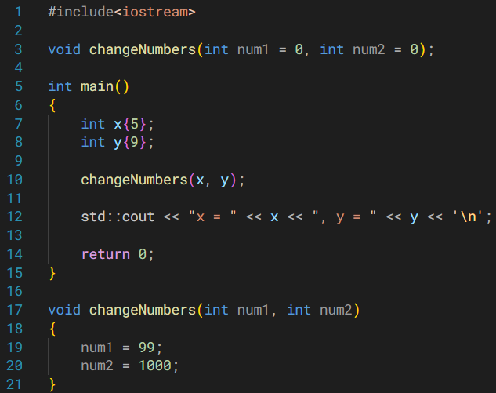
Note that copies of x and y are sent over to changeNumbers().
I am making modifications to the copies of x and y, therefore no changes are seen on x and y after coming back to main().
x
y
5
9
0x10
0x20
num1
num2
5
9
Copies
0x40
0x80

Slide 5
Pass by Reference
But what is a reference?

Slide 6
References in 3 Slides
References are aliases to existing variables.
Cannot be null.
Simply speaking, you have created another name (or identifier) for that same piece of memory.
ref and x can be used synonymously.
int x{ 9 };
int& ref{ x };
x
ref
9
0x10

Slide 7
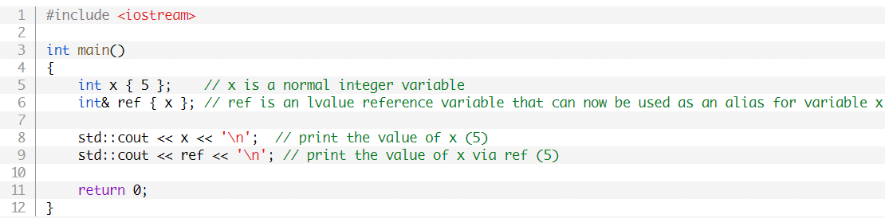
References in 3 Slides

Slide 8
References in 3 Slides
You can play around with x using ref like normal for the most part.
Note that references are not entities themselves.
std::cout << &ref; // will print &x (the address of x)
Also, ref cannot be bound to another data once initialized.
Note that this is unlike pointers.

Slide 9
Pass by Reference
Instead of creating copies with pass by value, you can pass by reference.
No copies are created.
The actual entity is being used directly.

Slide 10
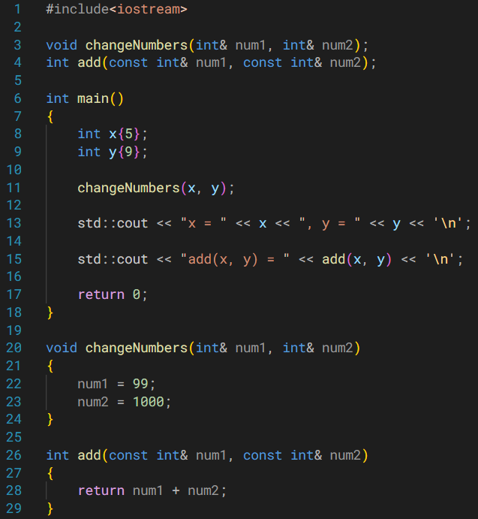
Note that x and y are being worked upon directly by changeNumbers().
I am making modifications to x and y directly. As such, we can see the changes in main().
Function is called in the same way.
x
num1
y
num2
5
9
0x10
0x20

Slide 11
If I don’t plan on modifying the arguments, I can instead pass by const reference.
This will prevent any modification of num1 (x) and num2 (y) in our example.
Function is called in the same way.
x
num1
y
num2
5
9
0x10
0x20

Slide 12
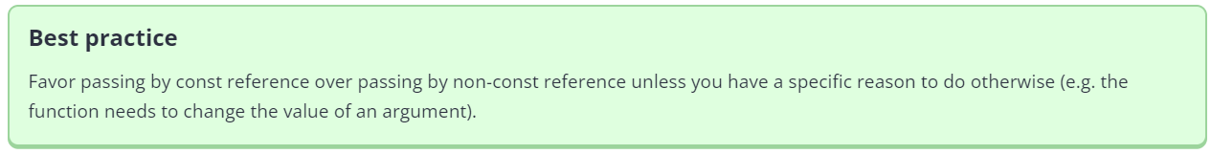

Slide 13
Pass by Reference
Why is this helpful when we have pass by value?
The reason is that some entities are expensive to copy.
For e.g. objects which are essentially collection of a lot of data.
As we saw, references are just another name to access the same entity.
So no additional copy is created.
Notes:
Btw, you cannot have default arguments if you have reference parameters in your function.
However, if you have a const reference parameter, then you can set default arguments. I think this has something to do with lvalues and rvalues. Const references can bind to rvalues (literals for e.g.) but non-const references can only bind to lvalues (variables for e.g.).

Slide 14
Pass by Address
Pointers again…

Slide 15
Pass by Address
Instead of passing variables or their references, we pass their addresses.
That means we are working with pointers.
Again, no copies of the variables are created since you are just passing the addresses.
Pointer variables, however, are created.
They are local to the function being called.

Slide 16
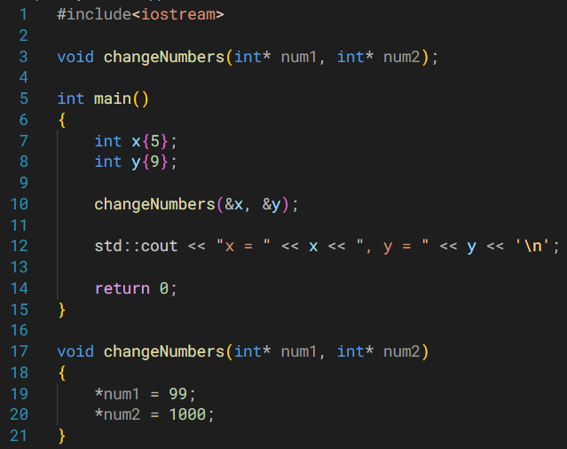
Note the change in function call – addresses are being passed.
Since we have the addresses of x and y, we are essentially messing around with them directly.
Hence, the changes made in the function will be seen in main().
Do you think any entity is created when changeNumbers() is called?
num1
num2
x
y
Pointers
&x
&y
5
9
0x40
0x80
0x10
0x20

Slide 17
Pass by Address
Just like in pass by reference, if you don’t expect to modify the values of your data, you can use pointer to const.
Your function declaration would look like the following.
void changeNumbers(const int* num1, const int* num2);
This will prevent any modifications within the function, i.e. you will be unable to do the following.
*num1 = 1000; // compile-time error

Slide 18

Notes:
You may end up passing nullptr when using pass by address accidentally. So you will have to check for null before dereferencing.
Other reasons as well: https://www.learncpp.com/cpp-tutorial/pass-by-address/

Slide 19
Return by Address Return by Reference
Return by address essentially means that your function returns an address (or a pointer).
You’ve probably been already doing this.
The return type of your function is a pointer type.
Return by reference – we will hopefully see this in OOP.

